Slide 1
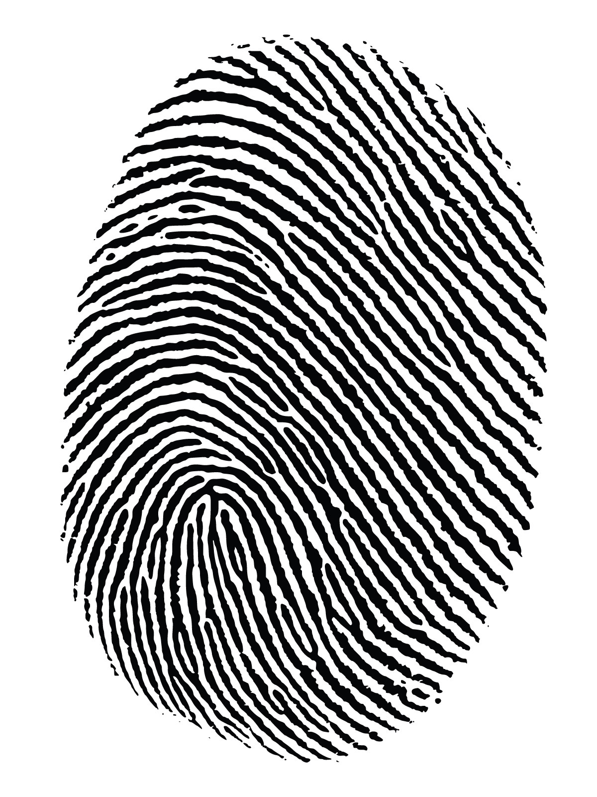

Getting more out of Sanger sequencing
Community DNA fingerprinting
Etienne Low-Decarie
Corey Chivers

Slide 2
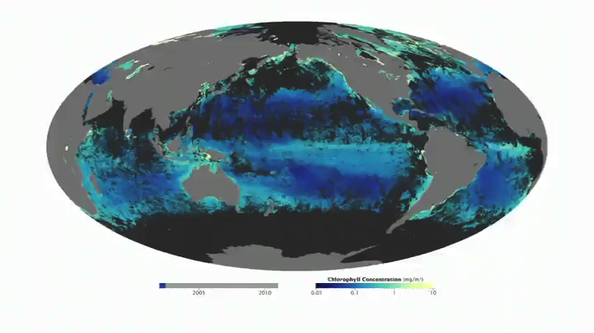

Microbial community composition
(phyto)plankton
soil decomposers
images: NHGRI and NASA

Slide 3
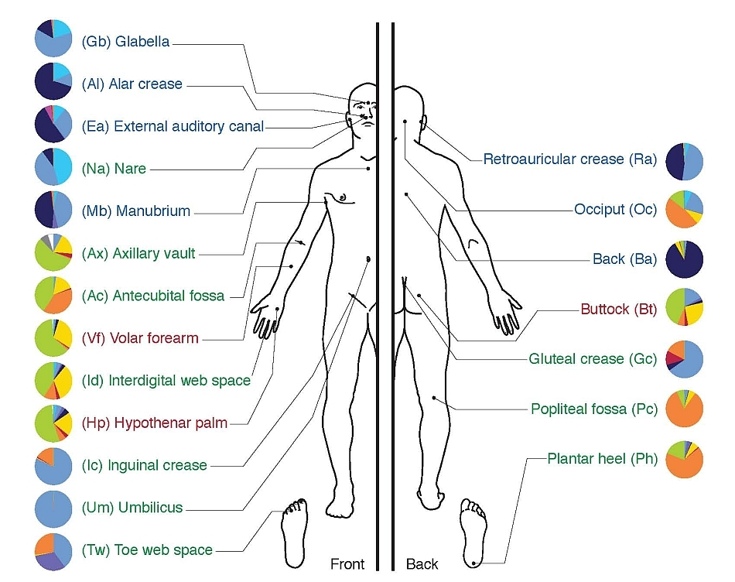
Microbial community composition
Human microbiome
images: NHGRI

Slide 4
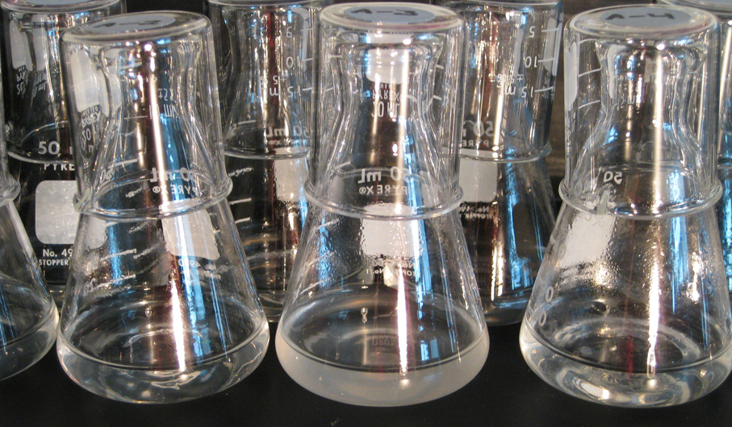
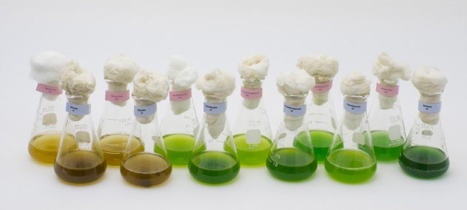
Microbial community composition
Experimental ecology and evolution
left image: Richard E. Lenski

Slide 5
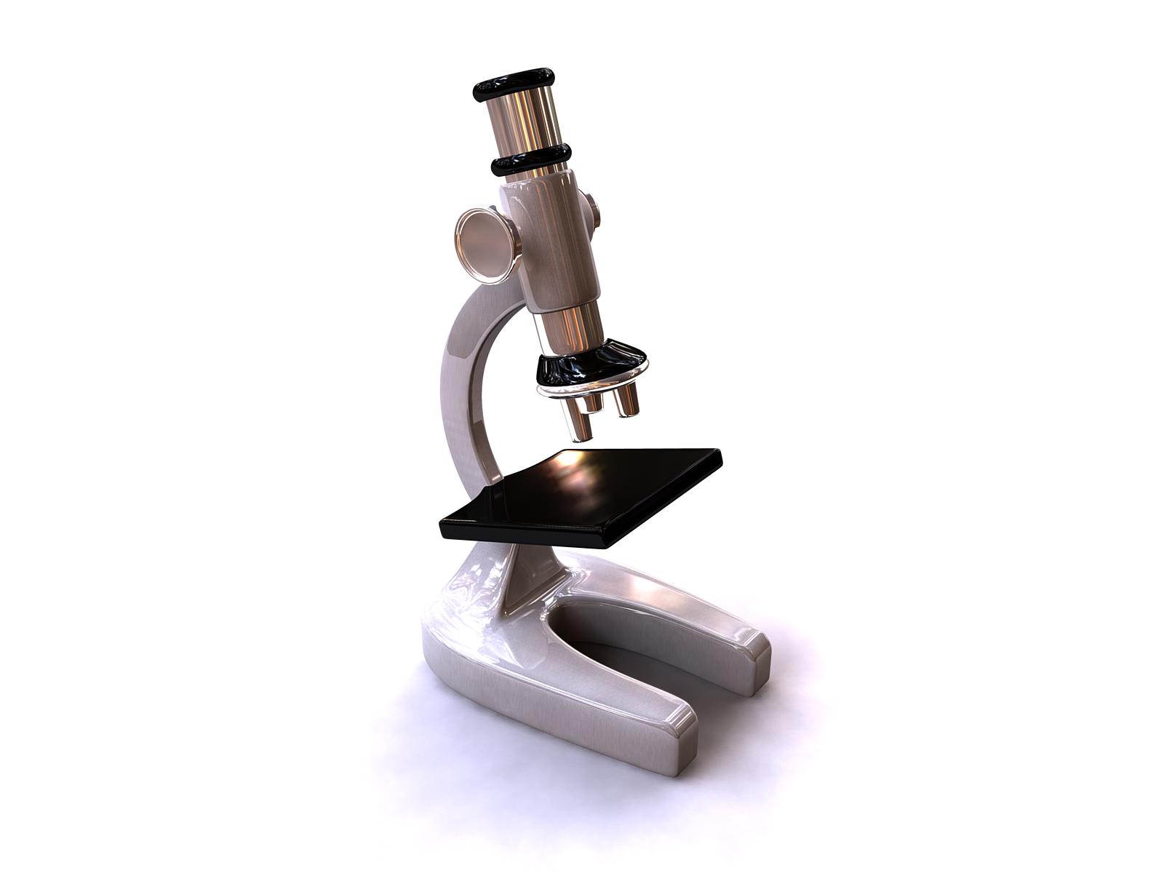
Limits of traditional taxonomy
Few microbes can be cultured
Many are not visually distinguishable
When at all possible
requires expertise
tedious
often unfeasible
…

Slide 6
Community fingerprint
Community level characteristic resulting from the proportional sum of characteristics of its constituent species
synonyms: profile
fingerprinting: using this characteristic to determine community composition
3x
2x
½ x

Slide 7
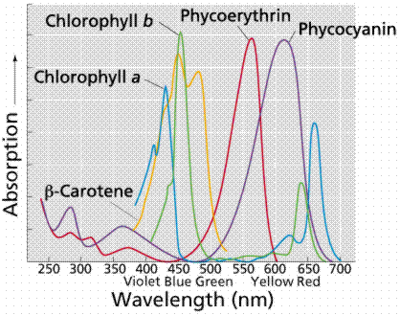
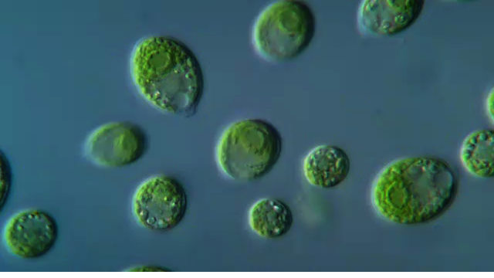
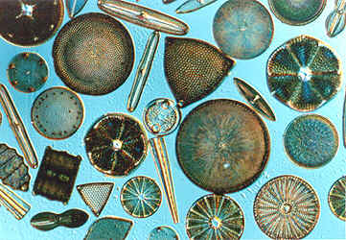
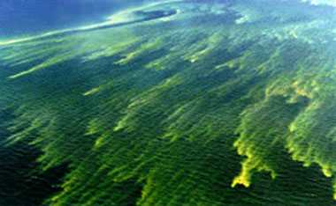
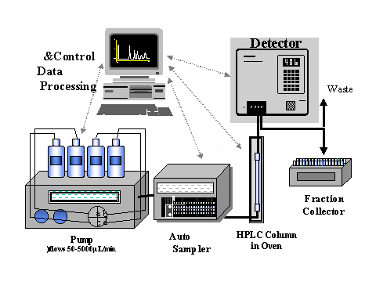

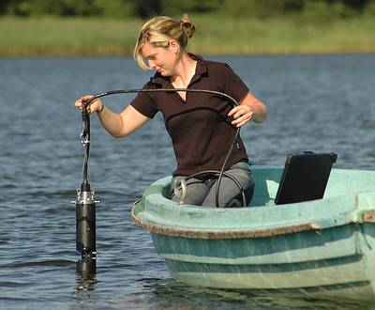

Pigment fingerprinting
images: Academy of Natural Sciences, BBE moldaenke and others

Slide 8
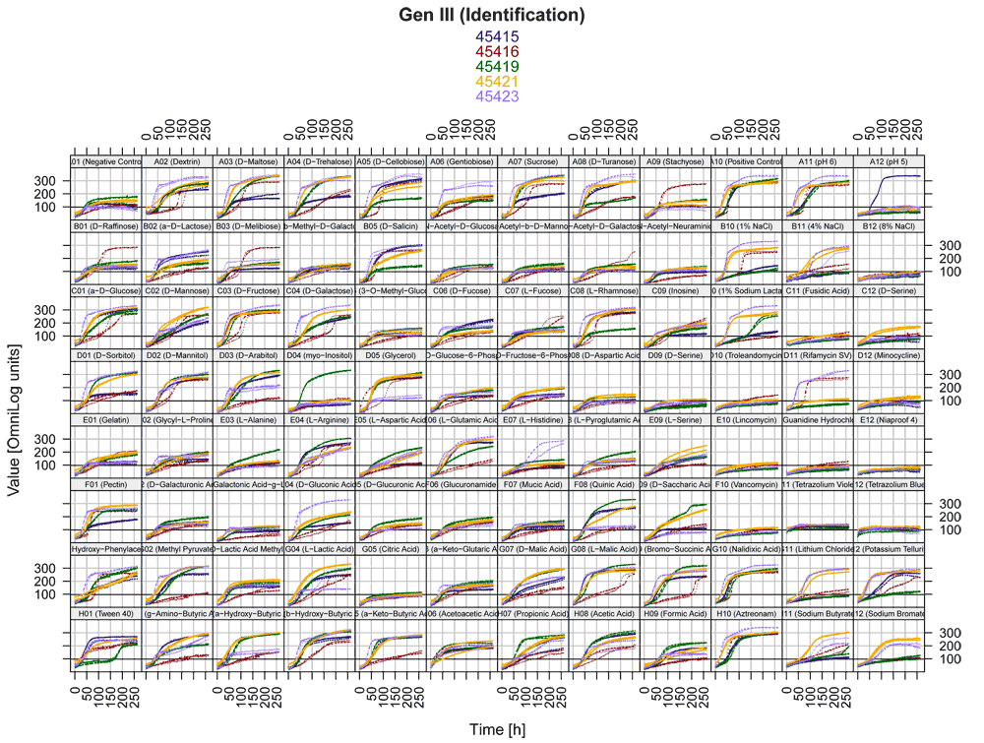

Physiological fingerprint
Sole carbon source utilization fingerprint
BIOLOG eco-plates
Toxicological finger print
Target specific antibiotic
Toxin and metals

Slide 9
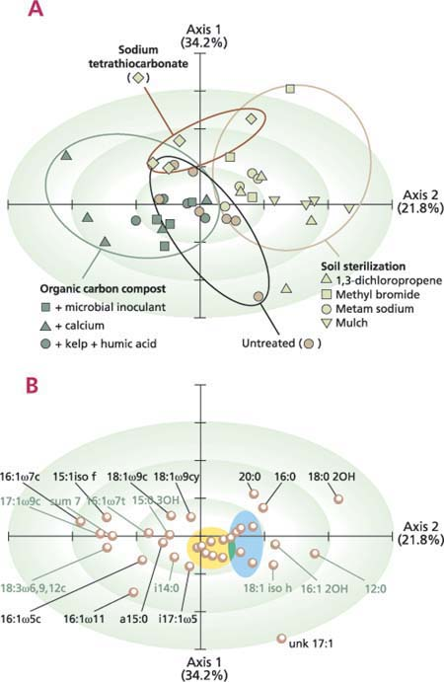
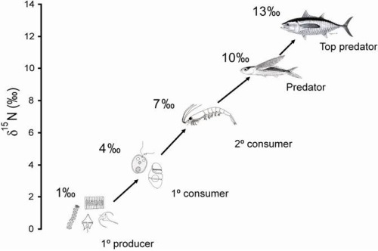
Chemical fingerprinting
Fatty acid fingerprinting
Fatty acid methyl ester (FAME)
Phospholipid fatty acid (PLFA)
Isotope fingerprinting
Trophic structure signal
images:Rebecca E. Drenovsky, Roger A. Duncan, Kate M. Scow,SPC ocean fisheries programme,

Slide 10
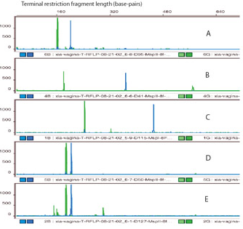
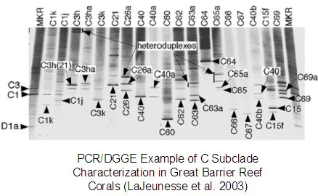
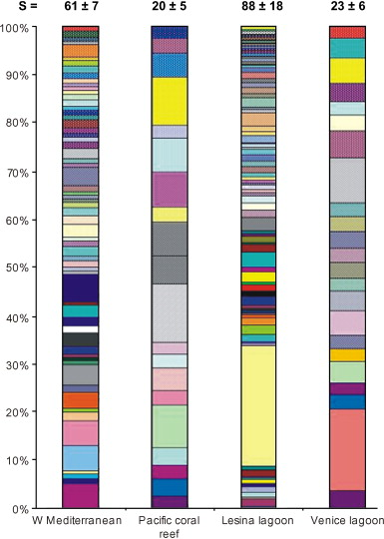
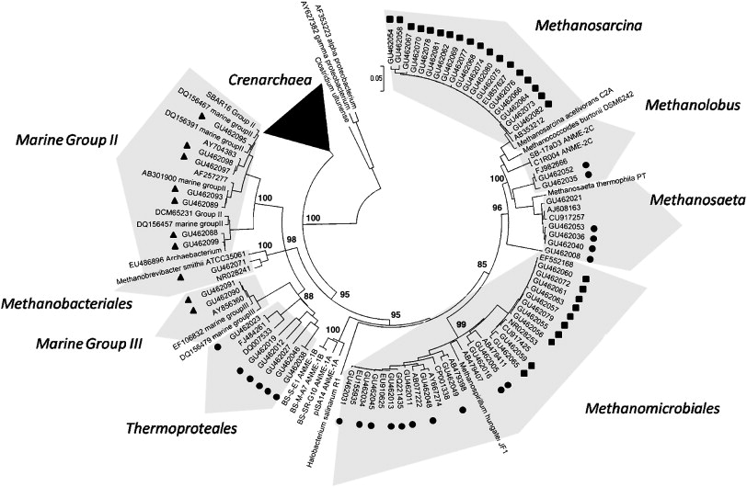
DNA fingerprints (metagenomics)
Terminal Restriction Fragment Length Polymorphism (T-RFLP)
Denaturing Gradient Gel Electrophoresis (DGGE)
Ribosomal Intergenic Spacer Analysis (RISA)
…
Cloning and (Sanger) sequencing
High-throughput sequencing
Reviews:
Nocker et al. 2007
images: Xia Zhou, Gregory W. Schmidt, Roberto Danovaro and Antonio Pusceddu,
Stephan Gantnera, Anders F. Anderssona, Laura Alonso-Sáeza, Stefan Bertilsson

Slide 11
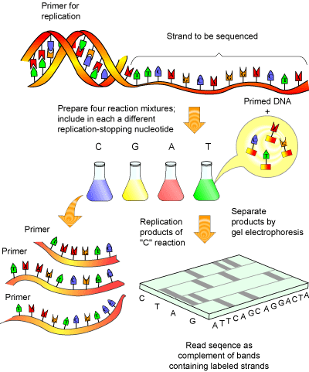
Chain-termination (Sanger) sequencing
NAGTCGTCCA
images: Helmut Kae

Slide 12
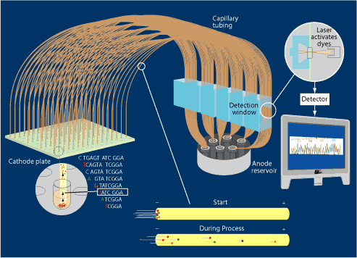
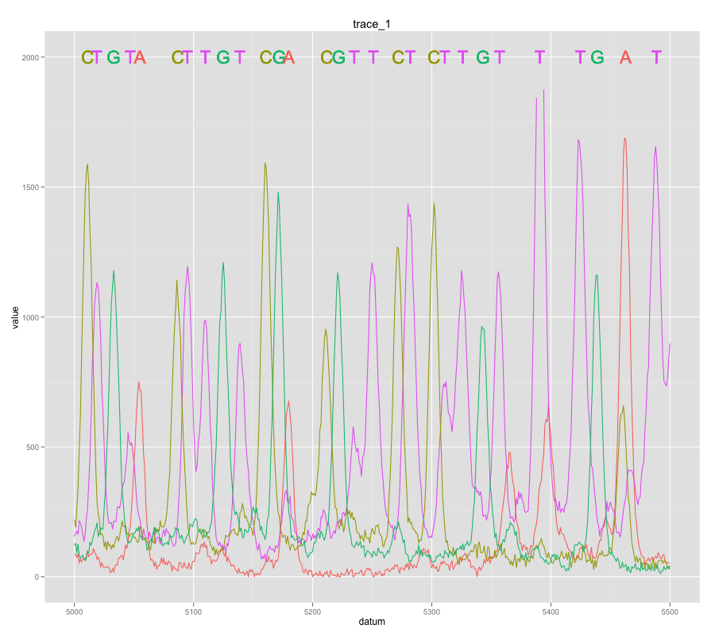
Chain-termination (Sanger) sequencing
images: Steven M. Carr

Slide 13
Heterozygote trace

Slide 14
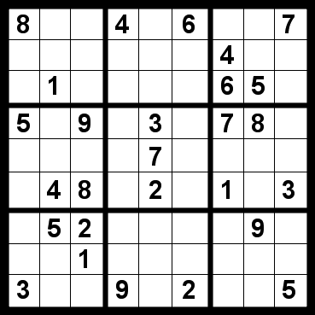

Our naïve logical leap
If it has not been done, chances are:
Can’t be done
Shouldn’t be done

Slide 15
Two type community trace
type: any taxonomic level with common primers and distinguishing loci
genotype, species, genus…

Slide 16
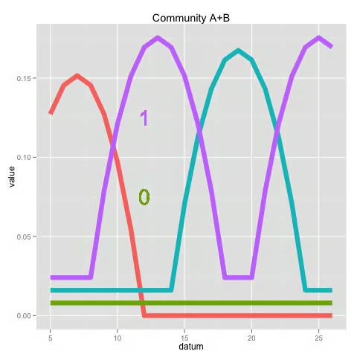
Two species community trace

Slide 17
Simulation

Slide 18
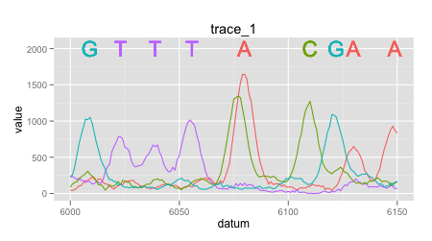
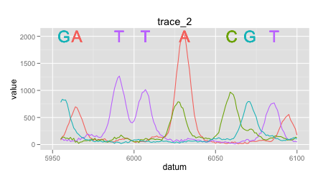
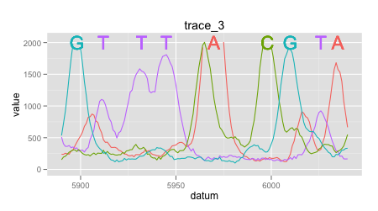
Two type trace

Slide 19
Quantification of visually aligned traces
Sum of square optimization
Trace improvement
Ratio
Base signal/sum of base signals
Remove effect of total signal amplitude
(Community - (quantity • Type 1 + quantity • Type 2))²
Notes:
I have removed the use of
Threshold
Values or summed values < 0 set to 0
Remove effect of low signal/high noise regions

Slide 20
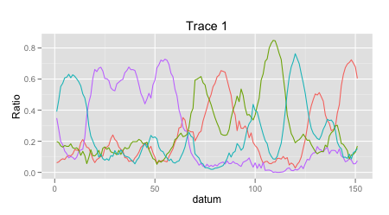
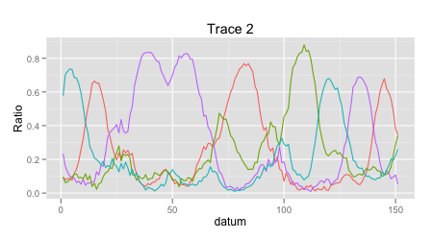
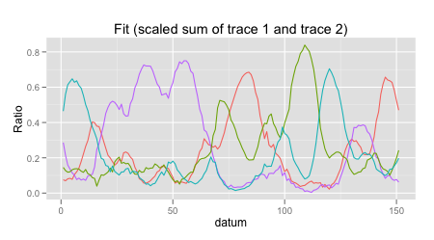
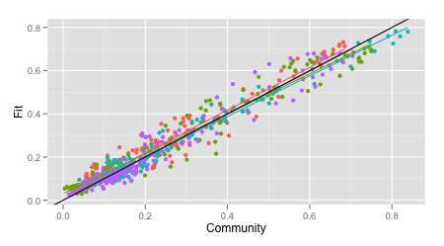
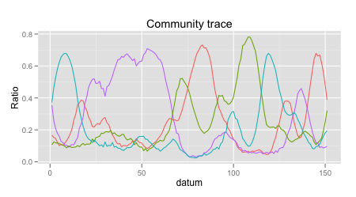
Quantification of visually aligned traces
0.519
0.453
R²>0.95
≈

Slide 21
Traces are shifted
Alignment
Segment shift through 0 padding
Discontinuous/rough surface
Grid search
Very costly (time~ range^{parameters})
potential alternatives
human eye
differential evolution
particle swarm
integer programing
0 0 0 0
0 0 0 0
0 0 0 0 0 0 0
0
0 0 0
0 0 0 0 0 0 0

Slide 22
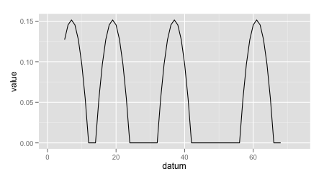
Traces contain drift
Only small segments can be aligned
Trace segmentation
Provides population with distribution as potential measure of error

Slide 23
Distribution of quantification with segmentation and alignment

Slide 24
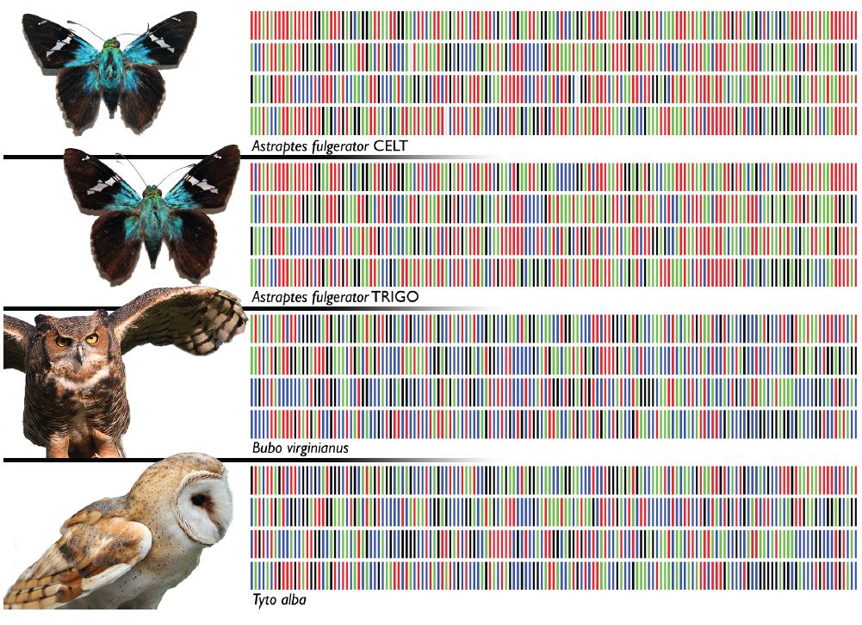
Using species DNA barcode
Generating trace simulation from barcode

Slide 25
Quantification steps
Align
Quantify

Slide 26
Potential advantages
Any taxonomic level/resolution
Species
Major group
Uses existing technology and infrastructure

Slide 27
Next steps
Get your expert opinion/feedback
…
Show proportion calculated=true proportion
Dilution series
Expand beyond two types
Improved optimization
Error structure
error of ratios are is not normally distributed
accounting for decreased reliability with length
Use conserved region for alignment and polymorphic sites for scaling

Slide 28
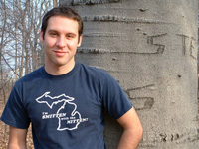
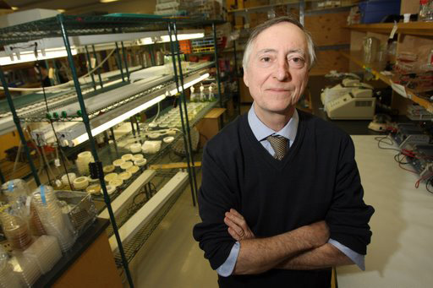
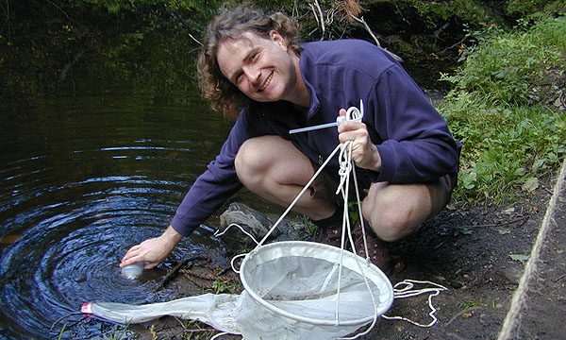
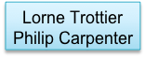




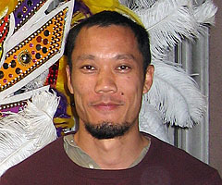




Acknowledgements
Adam Herman
Thomas Bureau
Genome Quebec
BELL LAB
FUSSMANN LAB
LEUNG LAB
Contacts and code
https://github.com/edielivon/community-DNA-fingerprinting
etienne.webhop.org etienne.low-decarie@mail.mcgill.ca

